Slide 1
Testing Levels
Regression Testing
Unit (Module) Testing
Module Integration Testing
Build Acceptance (Smoke) Testing
System (Certification, QA) Testing
Alpha Testing
User Acceptance Testing/Beta Testing
Summary

Slide 2
Unit or Module Testing
Purpose: Make sure every “unit” works correctly
Performed by developers
Should be well-documented but rarely is
Strategies:
White box (clear or glass box): developer should walk through the code line by line ensuring it does what is expected.
Black box: Module or object/class published interface (input and output values, error handling and functionality).

Slide 3
Module Integration Testing
Purpose: Make sure modules interact correctly
Performed by developers
Strategies:
Non-incremental Integration (Big-Bang)
Test each module independently then combine and test the whole system.
Incremental Integration
Add modules one at a time then test; no isolated testing
Bottom-up starting at the leaves using drivers only
Top-down starting at the root using stubs only
Each module requires a driver and one or more stubs
A driver simulates the function of the caller
A stub simulates the function of the called module

Slide 4
Build Acceptance (Smoke) Test
Purpose: Make sure build is ready to be tested
Performed by the independent system test team
Strategies:
Check a subset of the most important functionality for each module
Check all navigations between screens
Use small subset of regression tests
Excellent candidate for automation

Slide 5
Systems Testing
Purpose: Make sure that the systems meet all functional and quality requirements.
Strategies: Requirement-based testing techniques such as:
Equivalence Classes
Cause and Effect Graphs
Decision Tables
Decision Trees
Use Cases
State Models
These techniques are covered in details in the test design course and the requirement-based testing course.
Pre-requisite: Complete set of detailed functional and quality requirements
Must be performed by an independent testing group

Slide 6
Major Areas of Systems Testing
Functional Requirement Testing
Performance (Load, Resource Utilization, Stress) Testing
User documentation/Help Screens testing
Usability testing/User Interface testing
Operational Environment (Conformance) Testing
Interoperability (System Integration, End-To-End) Testing
Reliability/Availability/Stability Testing
Survivability (Robustness/Disaster Recovery) testing
Security testing
Safety Testing
Other types of testing??

Slide 7
Functional Requirement Testing
Purpose:
Make sure system does what it supposed to do (Positive Testing)
Make sure system does NOT do any thing it is not supposed to do (Negative Testing)
Requires complete, detailed, and unambiguous set of functional requirements.
When an anomaly is found:
Problem may be in system
Actual defect in design / code (create bug report)
Problem may be in requirements
Misunderstanding of user needs (clarify with developers and/or users)
Problem may be in test or in data!

Slide 8
Performance Testing
Measures a system’s performance under load. Includes:
Response time
Load
Stability
Resource utilization (disk space, memory, CPU)
Only possible using specialized tools to simulate load
Very much depends on how good the Use Profile of the system was modeled
Many variations, different terminology, and so much debate between practitioners

Slide 9
Some “Performance Testing” Definitions
The following definitions are attributed to Ross Collard
Load Test: a measurement of performance under heavy load (peak or worst-case)
Stress Test: pushes the load beyond specified or expected limits
Response Time Test: measures how long to complete a group of tasks
Throughput Test: measure the amount of data through the system under load
Capacity Test: measure the ability of a system to support additional workload without degrading performance unacceptably.

Slide 10
Some “Performance Testing” Definitions
Duration Testing: places a load on system for an extended time looking for degradation of service
Hot Spot Test: stressing a particular sub-system looking for a weak point
Spike (Bounce) Test: injecting a very high load for a short time to see how system handles a sudden increase in load
Breakpoint Test: increase load up to breaking point to determine the break-down characteristics
Rendezvous Test: spike testing where many of the same event occur simultaneously (i.e. everyone logging into email at the same time.)

Slide 11
User Documentation/Help Screens Testing
Purpose: Make sure all instructions in user documentations and help screens are consistent with the way the system functions.
What to test?
Help files
User manuals
Installation docs
Support docs
Rollout plans

Slide 12
Usability Testing
Purpose: Make sure the user interface follows certain guidelines that make the application easy to use by users. May include getting real users involved
Ease of accessibility (get to needed area)
System responsiveness (time lag)
Efficiency (minimum effort needed)
Understandability
May be unscripted (ask user to perform task and let them figure it out)
Best of guided by a checklist

Slide 13
An Example A Usability Checklist
1. Simple and natural dialogue
2. Speaks the user’s language
3. Minimizes user memory load
4. Consistent
5. Provides feedback
6. Provides clearly marked exits
7. Provides shortcuts
8. Provides clear error messages
9. Prevents user errors

Slide 14
User Interface Testing
Purpose: Make sure the UI works correctly and adheres to standards
Test the initial state of every window and menu system
Cursor position on every window
Enable/Disable states of controls and menu items
Test all changes in the enable/disable state
Test the tabbing sequence for each window
Test cross-application navigation while different types of windows are open
Test for Undo, Redo, Drag and Drop, etc.
Internationalization testing
Test all navigation lines on the navigation diagram
Technique: Use a UI Navigation Diagram/Matrix to represent the flow between different screens and menu items.

Slide 15
When Do We Do UI Testing?
The majority of UI testing must be performed before systems testing
More aspects of UI testing will be exercised during systems testing

Slide 16
Alpha Testing
Customers and end-users run the software in a supervised in-house environment.
Focus is typically on usability issues

Slide 17
User Acceptance Testing/Beta Testing
A user-version of system-testing
Customers and end-users run the software in a “production-like” environment.
Maybe performed by a dedicated user level test team.
Acceptance test criteria may be part of a contract
Beta testing is the form of UAT used for publically sold commercial software
Different models depending on the level of involvement of the system test team.

Slide 18
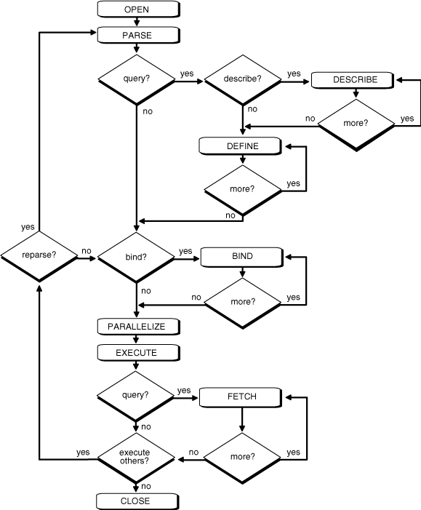
How a Code Coverage Tool can Help System Testers Identify and Reduce Risk
Timothy D. Korson
tim_korson@IIST.org
Senior Instructor, IIST

Slide 19
Identify and Reduce Risk
All kinds of Risks
Shipping code with errors we should have found

Slide 20
Fact
Commercial systems are full of code that is not traceable to the requirements!
Test cases derived only from the requirements, leave much of the code untested!

Slide 21
What is in the Code that is Not in the Requirements?
Lots of stuff, including:
Technology code
Inter-process communication
Database Access
Encryption
Compression
Optimization
Error Handling
Undocumented requirements

Slide 22
Example - Optimization
If number_of_employees < 50 then insertionsort (employee_file)
If number_of_employees > 50 then quicksort (employee_file)
…
Cannot know from the requirements
that 50 employees is a boundary condition

Slide 23
White box testing example
Prompt (filename)
If size(filename) > 10 meg then filename = compress (filename)
End if
Attach(filename, message)
Send(message)
…
Cannot know from the requirements
that 10 meg is a boundary condition

Slide 24
Result
Test cases derived from the requirements only, often leave over half of the code untested from a system test perspective.

Slide 25
Recommendations
At the Primitive Component Level
Require 100% code coverage
As integration proceeds try to keep to 100% until it become infeasible
100% code coverage at the system level for today’s complex distributed systems is nearly impossible, however
50% code coverage at the system level is insufficient! But it is common.

Slide 26
How?
I’m a tester, not a programmer!
They do white box, I do black box

Slide 27
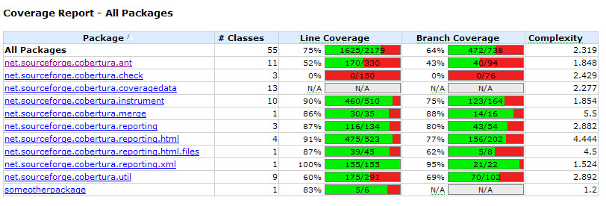
Code Coverage Tools Example Summary Report
Cobertura

Slide 28
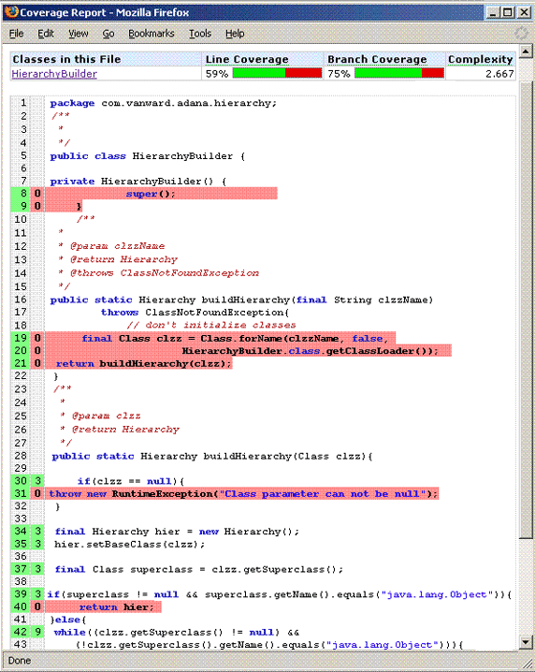
Code Coverage Tools – Sample Detail Screen
Cobertura

Slide 29
Unit 4
Test First Development

Slide 30
Test First
Many programmers have adopted this approach with near religious zeal
“Test-first design is infectious! Developers swear by it.
We have yet to meet a developer who abandons test-first design after giving it an honest trial.”
Robert C. Martin

Slide 31
The Process
Write a test that specifies a tiny bit of functionality
Compile the test and watch it fail (you haven't built the functionality yet!)
Write only the code necessary to make the test pass
Refactor the code, ensuring that it has the simplest design possible for the functionality built to date
Repeat

Slide 32
The Philosophy
Tests come first
Test everything
All unit tests run at 100% all the time

Slide 33
Implications
Code is written so that modules are testable in isolation.
Code written without tests in mind is often highly coupled, a big hint that you have a poor object-oriented design. If you have to write tests first, you'll devise ways of minimizing dependencies in your system in order to write your tests.
The tests act as documentation.
They are the first client of your classes; they show how the developer intended for the class to be used.
The system has automated tests by definition.
Measurable progress is paced.
Tiny units of functionality are specified in the tests. Tiny means seconds to a few minutes. The code base progresses forward at a relatively constant rate in terms of the functionality supported.
Unit testing actually gets done
Once the code is written, the incentive to write tests is reduced. After all it compiles and runs!

